Slide 1
Communicating with Data – Introduction to Interactive Visualization
Dr. Ab Mosca (they/them)
Slides based off slides courtesy of Jordan Crouser (https://jcrouser.github.io/)

Slide 2
Announcements
On 11/07 we will have a guest lecture from the Spatial Analysis Lab (SAL) on geospatial visualization

Slide 3
Plan for Today
Interaction: a definition
Interaction with data and problem space
Relationship between interaction and understanding
Interaction with visual interfaces
Basic interaction types
Demo: coordinated multiple views

Slide 4


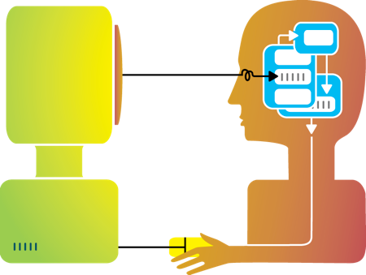
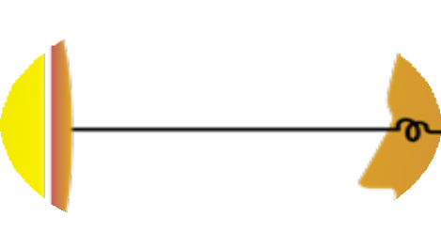
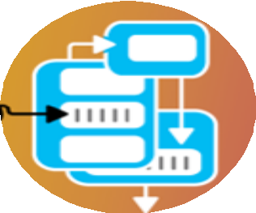




Rewind
Humans and machines have complimentary strengths
Visualization
Perception
and context
Interaction
Computational power
Image credit: Ali Ansari

Slide 5
Interaction (def.)
“Interaction for visualization is the interplay between a person and a data interface involving a data-related intent, at least one action from the person and an interface reaction that is perceived as such.”
Mandatory Components
Interplay
Person
Data Interface
Action
Action-Reaction
Reaction Perceived as Such
Data-Related Intent
What is Interaction for Data Visualization? Evanthia Dimara, Charles Perin. 2020
Notes:
Interplay – “dialogue”
Person -
Data Interface– the vis
Action – Any action, physical or mental, regardless of modality that causes the reaction of the data interface
Action-Reaction– cause effect between entities
Reaction Perceived as Such – person must perceive the reaction in the data interface
Data-Related Intent – intent is tied to a data source and is formed iteratively throughout the interaction cycle

Slide 6
Methods by which humans create knowledge through the manipulation of an interface
Low level: between human and interface
the set of operations available
the relationship between the human and the visualization
High level: between human and problem space
a cognitive act enabled by the tool
does not need to take place exclusively within them
might be distributed across multiple tools
Interaction

Slide 7
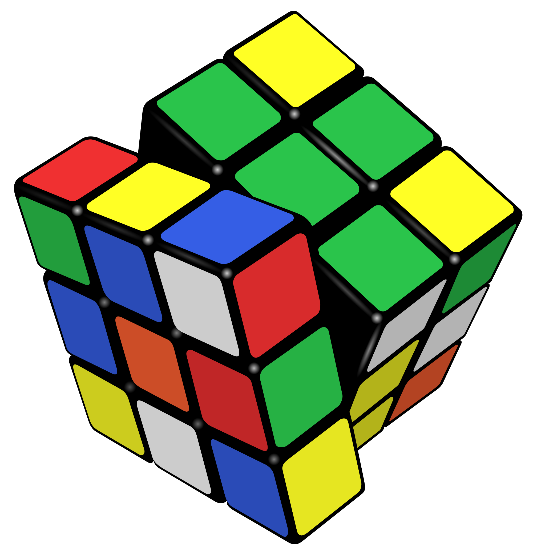
Example: Rubik’s Cube
What low-level interactions can you have?
What high-level interactions can you have?

Slide 8
Part I: High Level
Interaction with
Data / Problem Space

Slide 9
High-level interactions with a visualization correspond to analysis tasks
We can think about why users perform tasks (interactions) at different levels of specificity
High – consume vs. produce
Mid – search
Low – query
Brehmer and Munzner (2013)
M. Brehmer and T. Munzner, "A Multi-Level Typology of Abstract Visualization Tasks," in IEEE Transactions on Visualization and Computer Graphics, vol. 19, no. 12, pp. 2376-2385, Dec. 2013, doi: 10.1109/TVCG.2013.124.

Slide 10
Consume
Present
Telling a story with data, guiding an audience through a series of cognitive operations
Discover
Generation and verification of hypotheses, associated with models of scientific inquiry
Enjoy
Casual encounters with visualization
User is not driven by a need to verify or generate a hypothesis; novelty stimulates curiosity and exploration
Consume vs. Produce
Notes:
Presentation using visualization may take place within the context of decision making, planning, forecasting, and instructional processes
Discover - Scientific investigation may be motivated by existing theories, models, and hypotheses, or by the serendipitous observation of unexpected phenomena
Enjoy - Casual encounters with visualization can be fleeting, such as in the earlier example of encountering a static choropleth electoral map while reading a blog post. Conversely, these encounters might be immersive and time-consuming experiences, such as in museum settings

Slide 11
Produce
Use visualization to generate new artifacts. Ex.
Transformed or derived data
Annotations
Recorded visualization interactions
Screen shots of static visualizations
Consume vs. Produce

Slide 12
Hi
Search

Slide 13
High-
Query

Slide 14
Part II: Low Level
Interaction with
a Visual Interface

Slide 15
Yi, Kang, Stasko and Jacko (2007)
Select: mark something as interesting
Explore: show me something else
Reconfigure: show me a different arrangement
Encode: show me a different representation
Abstract/Elaborate: show me more or less detail
Filter: show me something conditionally
Connect: show me related items
Yi, J. S., ah Kang, Y., Stasko, J. T., & Jacko, J. A. (2007). Toward a deeper understanding of the role of interaction in information visualization. Visualization and Computer Graphics, IEEE Transactions on, 13(6), 1224-1231.

Slide 16
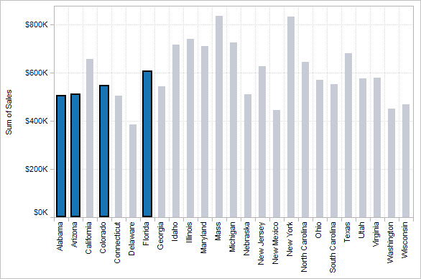
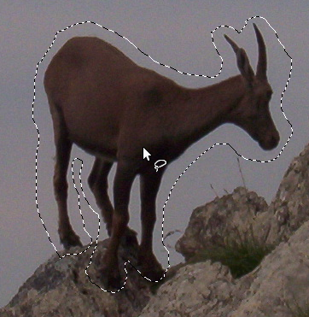

1. Select
Mark something as interesting: direct

Slide 17
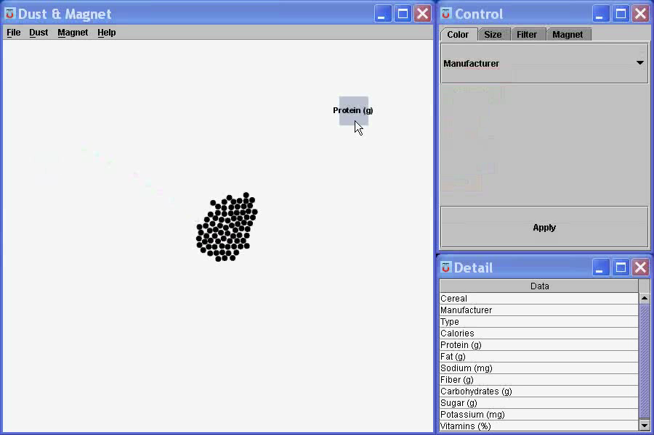
Mark something as interesting: indirect
1. Select
Notes:
What are you selecting? One item at a time?
Selecting of a value?
Selecting of a range?
Selecting of a position on the screen?

Slide 18
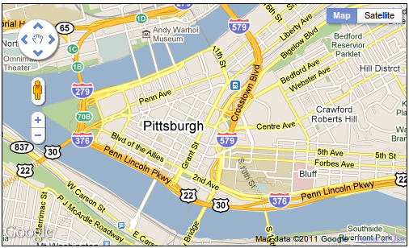
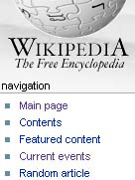
Show me something else
Scroll bars
Panning
Direct-Walk (e.g. hyperlink traversal)
2. Explore

Slide 19
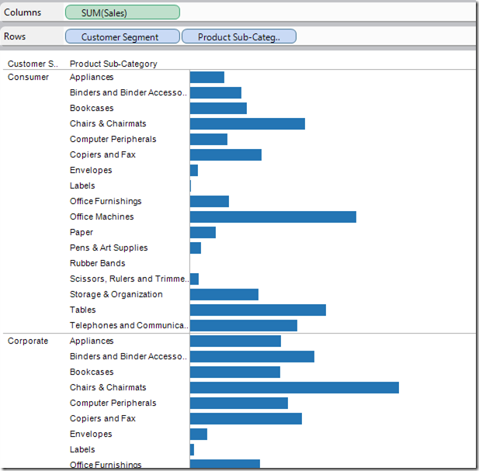
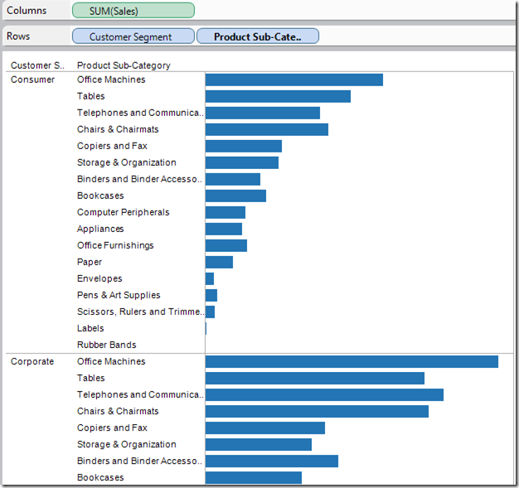
3. Reconfigure
Show me a different arrangement: sorting

Slide 20
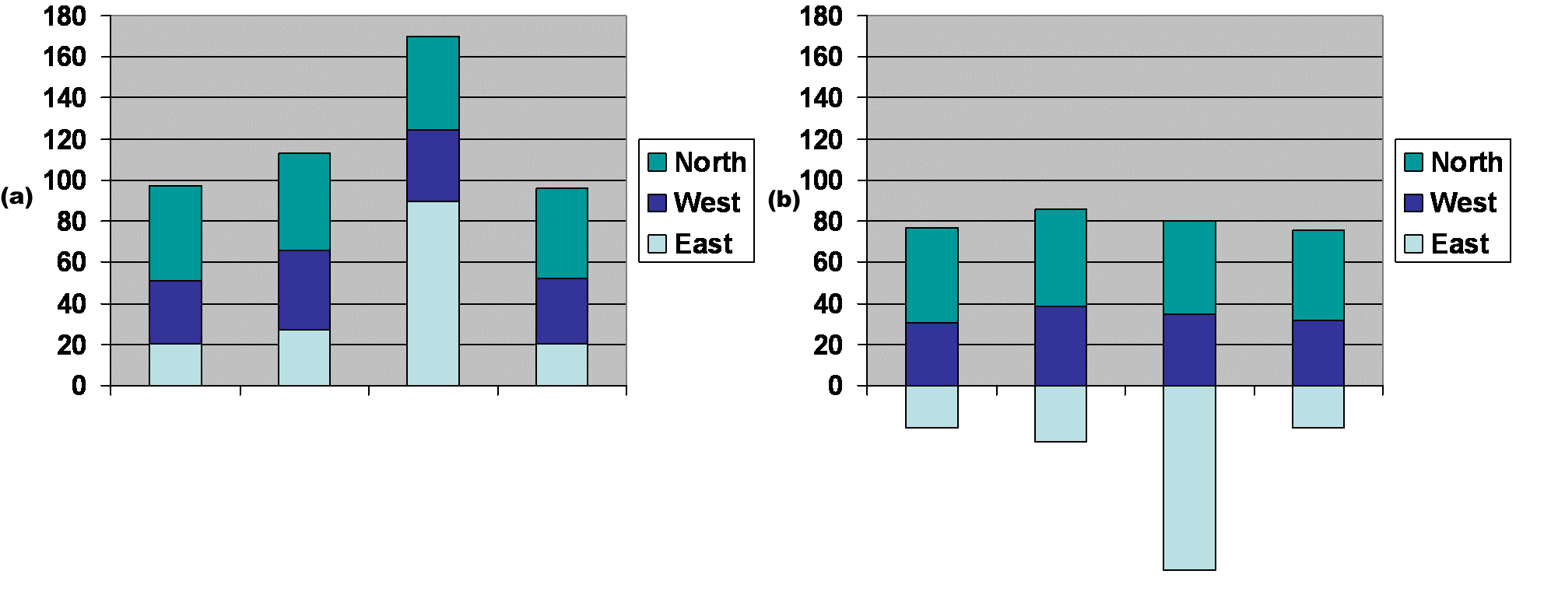
3. Reconfigure
Show me a different arrangement: baseline adjustment

Slide 21
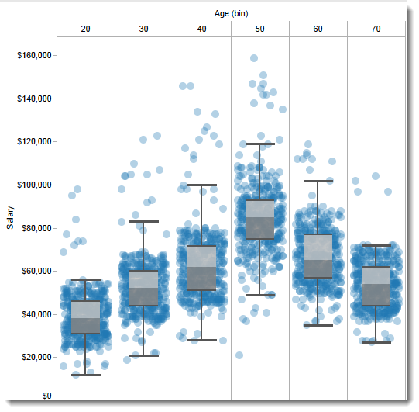
Show me a different arrangement: reduce occlusion (jitter)
3. Reconfigure

Slide 22
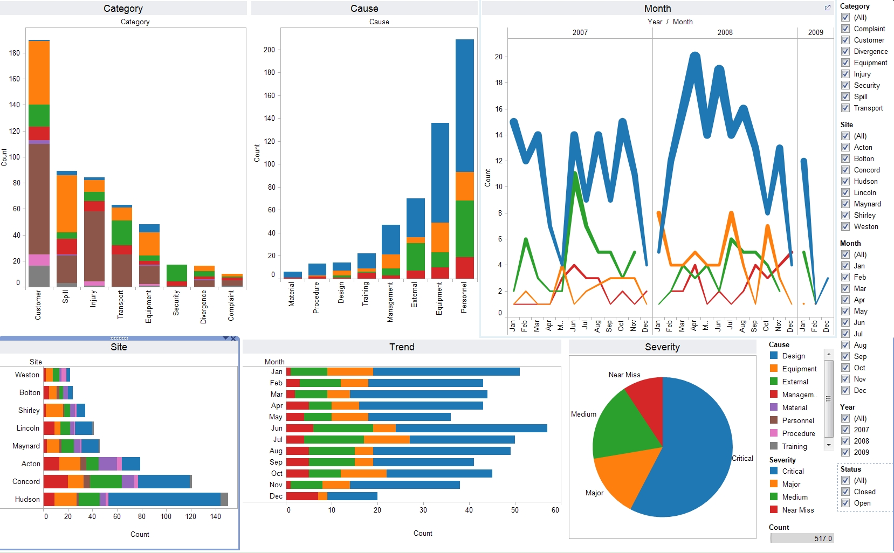
4. Encode
Show me a different representation: visualization type, color, size, orientation, etc.

Slide 23
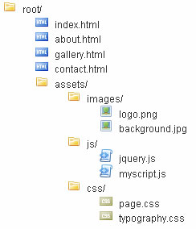
5. Abstract / Elaborate
Show me more or less detail: drill up/down

Slide 24
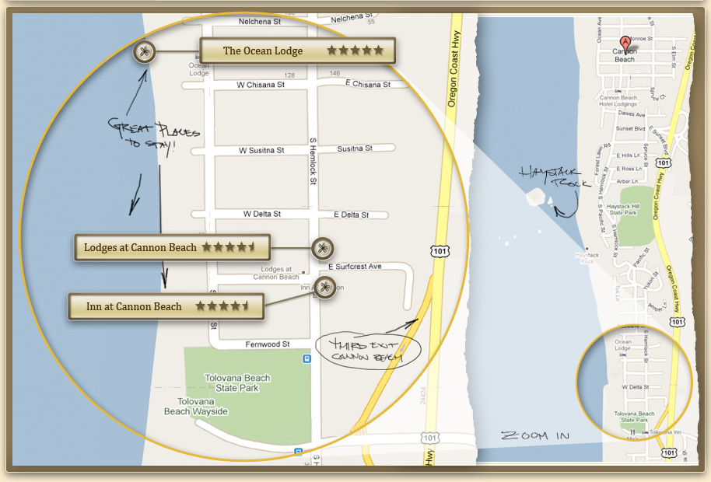
5. Abstract / Elaborate
Show me more or less detail: zooming

Slide 25
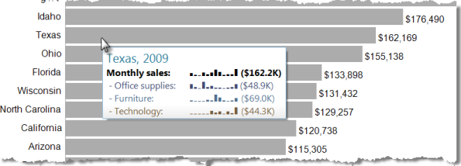
5. Abstract / Elaborate
Show me more or less detail: tooltips

Slide 26
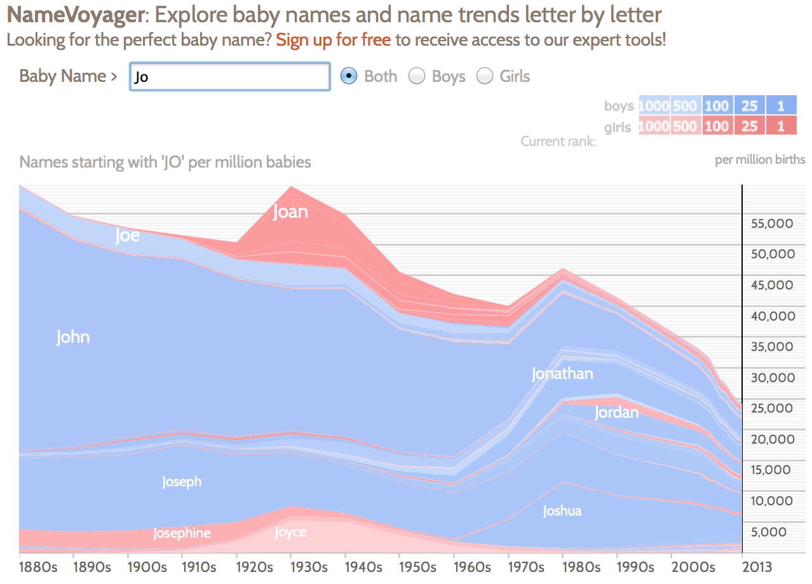
Show me something conditionally
6. Filter

Slide 27
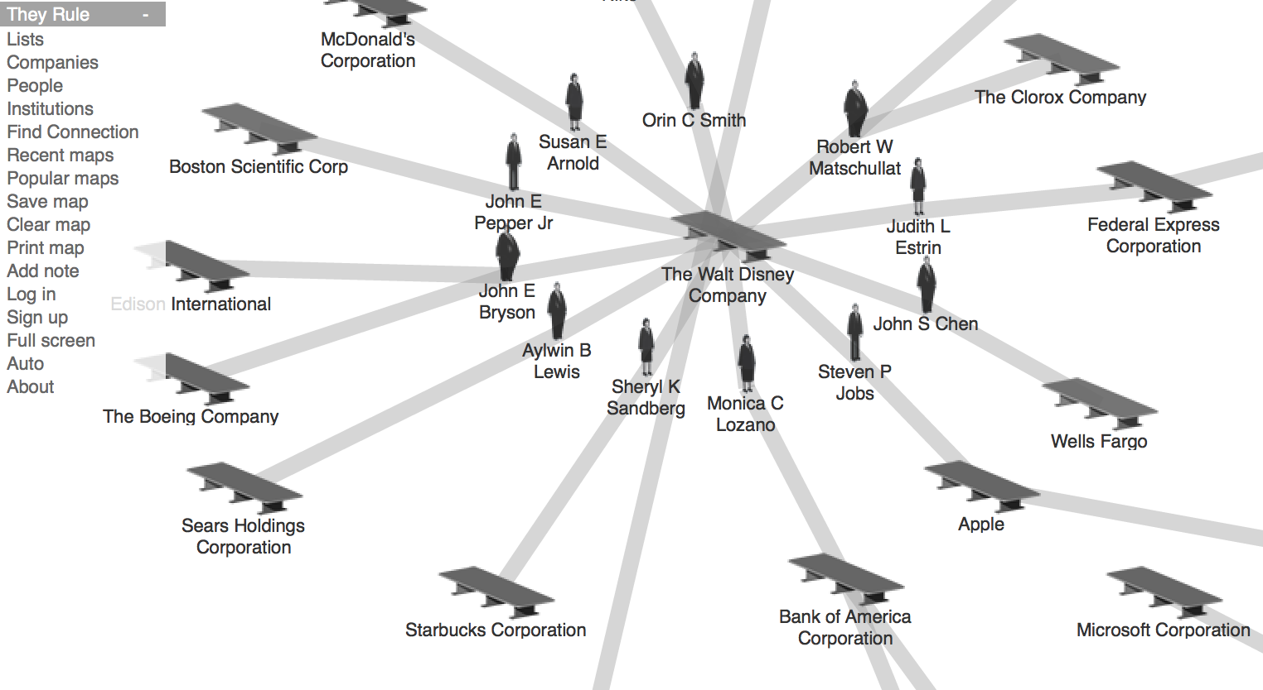
7. Connect
Show me related items: build-out

Slide 28
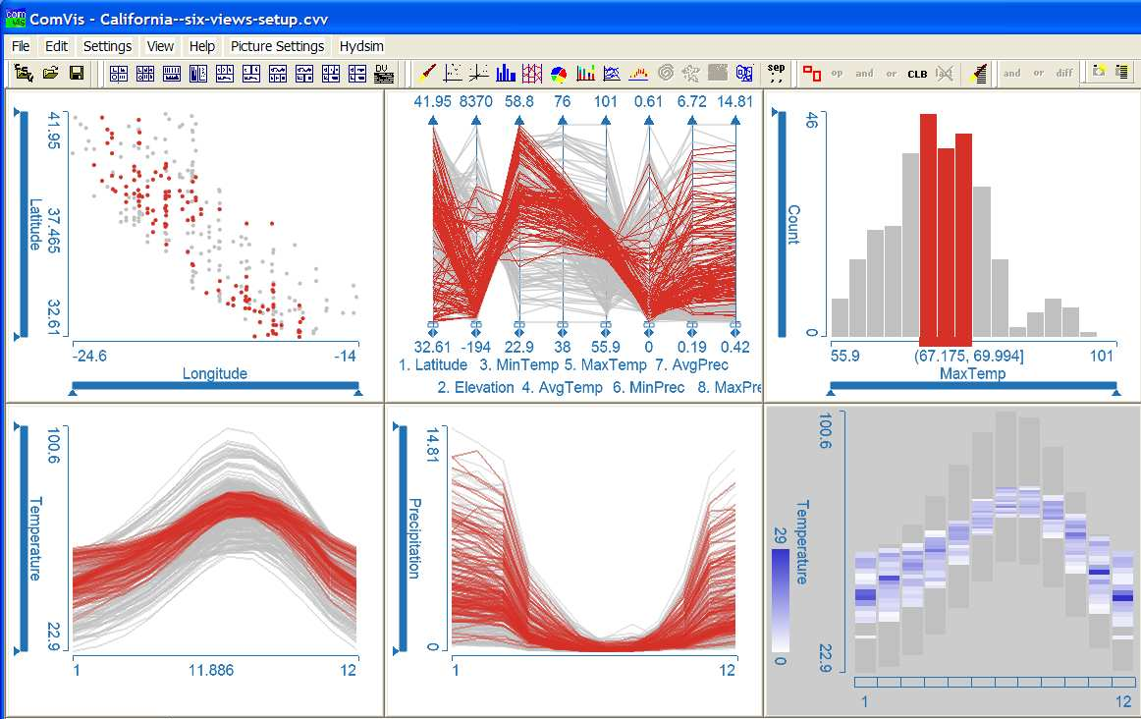
Show me related items: coordinated multiple views (CMV)
7. Connect

Slide 29
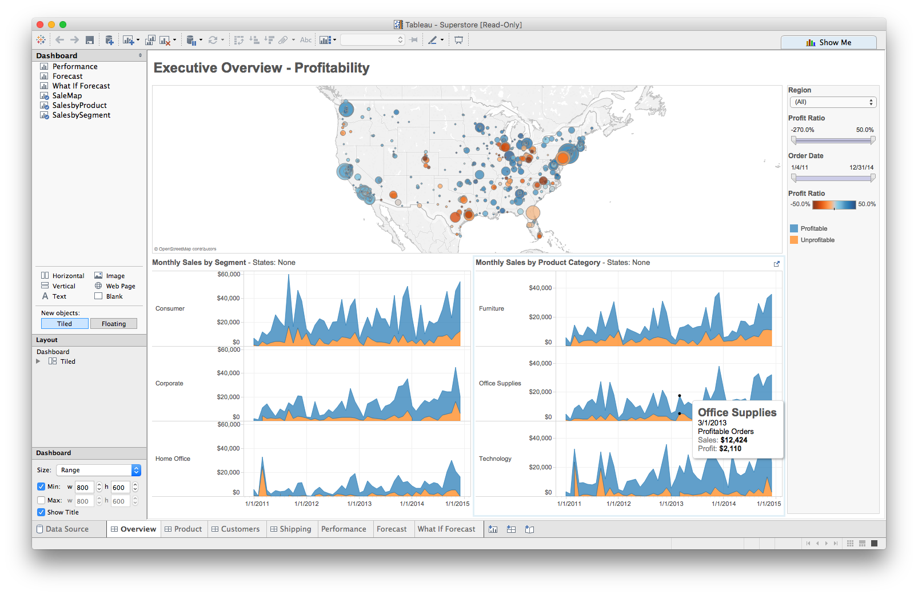
Foreshadowing: Multiple views
Different
representations
Different
data
Systems that use two or more distinct views
to support the exploration of a single concept or domain

Slide 30
Discussion
What would we need to make this work?

Slide 31
Suggested questions to ask when designing
What is the goal of the analysis?
Decision-making
Better understand a domain or a problem
Identify the trends of a phenomenon
Forecast the future
…etc.
What kinds of operations do we need to enable?
How can the visualization support those operations?

Slide 32
Tableau CMV walkthrough and exploration
Demo: coordinated multiple views

